Slide 1

Lecture-3: 09.06.22
Systems Engineering & Project Management
(Course Code: OAN0710)
Book:
Systems Engineering Principles and Practice
Authors: Alexander Kossiakoff, William N. Sweet, Samuel J. Seymour, Steven M. Biemer
Publication: A JOHN WILEY & SONS, INC. PUBLICATION, ISBN:978-1-118-00903-1
Prof. Amitava Mitra
(amitra@iitj.ac.in)
&
Dr. Mithu Rani Kuiti
mithu@iitj.ac.in)

Slide 2
What is Project ?
Project is defined as a unique process, consists of a set of coordinated and controlled activities with start and finish dates, undertaken to achieve an objective confirming to specific requirements, including the constraints of time and resource.
Example of Project:
Developing vaccine for COVID-19 disease,
Manufacturing of rails for high speed trains in India,
Development of highway for interstate transportation,
Development of software for on-line teaching.
Projects share the following common characteristics.
Unique in nature.
Have definite objectives (goals) to achieve.
Requires set of resources.
Have a specific time frame for completion with a definite start and finish time.
Involves risk and uncertainty.
Requires cross-functional teams and interdisciplinary approach.

Slide 3
Four major constrains of a project are:
The SCOPE:
It is the boundary of a project that the beneficiaries and the donors expect from the project
The SCHEDULE:
It is defined as the time required to complete the project
3. The COST:
This is the approved budget by which the resources such as personnel, equipment, services and materials are acquired
Scope
COST
4. The Quality:
It is defined as the conformance to requirements or fitness for use as per expectations of beneficiaries and the donor agency
Quality
Time
Project management Objectives
Quality Triangle
The objectives (or goal) of project management are:
To complete the project within the allotted (or budgeted) funds
To complete the project within the scheduled time limit
To ensure the project fulfil its scope
To execute the project in such a way that the project meets the quality standard and hence satisfy the end users

Slide 4
Systems Engineer & Project Manager
The systems engineer working on a project will plan, monitor, confront risk, and deliver the technical aspects of the project, while the project manager is concerned with all activities, including technical activities, which need to be integrated and controlled during the life of the project.
The systems engineer follows the Systems Engineering Body of Knowledge (SEBoK) whereas the Project engineer follows the Project Management Body of Knowledge (PMBoK)
There may be a overlap of responsibility which may create confusion and tension between the rolls of project manager and the systems engineer.
The three situations exist as shown in the following diagrams :
In some projects, there is no overlap in responsibility (fig.-a).
In other projects, there may be shared responsibilities for planning and managing activities (fig-b).
In some cases, particularly for smaller projects, the project manager may also be the lead technical member of the team performing both roles of project manager and systems engineer (fig.-c).
Project Manager
Systems Engineer
Project Manager
Project Manager
Systems Engineer
Project Manage/Systems Engineer
Fig.-(a)
Fig.-(b)
Fig.-(c)

Slide 5
Prejudices and misconceptions about Systems Engineering
Systems Engineering (SE) is nothing more than common sense
SE is just engineering , we do it as part of Mech. Engg, Computer Science Engg. etc.
SE is just for big defence and aerospace projects- it doesn’t apply to me
SE only applies at the early stages of a project (or to requirement)
SE people are ‘Technician’ /Geeks (not pragmatic)
All we require Project Manager (PM) not SE
In reality,
System engineering works almost between the Project Manager(PM) and technical teams. They ensure fulfilling of all technical scope, make sure resources meet deadlines & activities that put in place by the PM, and make sure resources aren't just wildly booking to projects.

Slide 6
Systems Engineering:
The function of systems engineering is to guide the engineering of complex systems.
“To lead, manage or direct” the team based on superior experience in persuading the task
&
“To show the way” for successful implementation of the given task
Systems in which the elements are diverse and have intricate relationships with one another.
Home appliance such as a washing machine would not be considered sufficiently diverse and complex to require systems engineering, even though it may have some modern automated attachments.
In the context of an engineered system excludes such complex systems as living organisms and ecosystems.
Primary function of systems engineering
To emphasize the process of selecting the efficient and economical path for others to follow from among many possible courses.

Slide 7
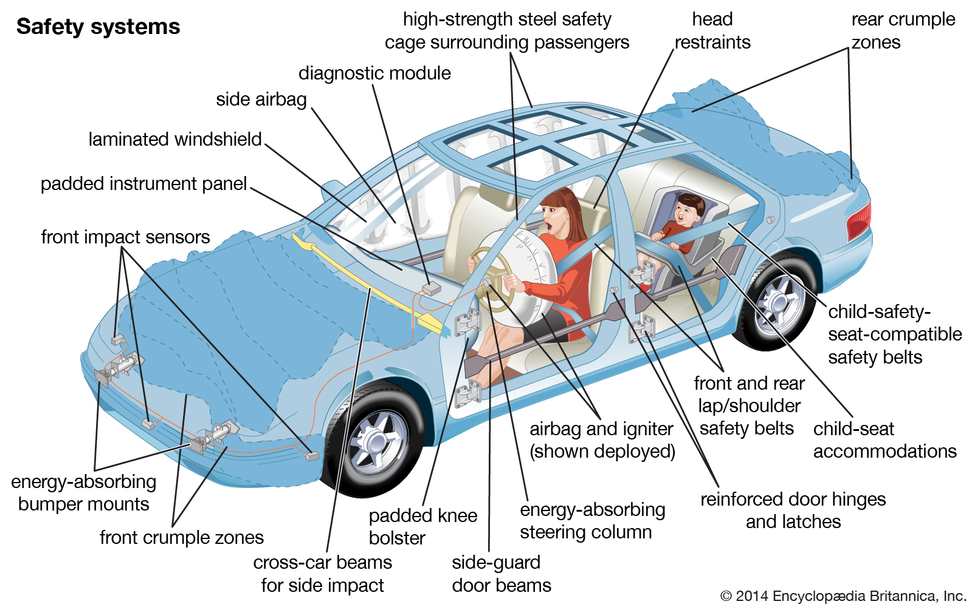
Complex System: A Fully Equipped Modern Passenger Automobile
It is made up of a large number of diverse components requiring the combination of several different disciplines.
Modern Automobile operate efficiently at the same time maintaining very close control of engine emissions which requires
sophisticated sensors and computer - controlled mechanisms for injecting fuel and air.
Advanced materials and computer technology are used to an increasing degree in
passenger protection, cruise control, automated navigation, autonomous driving and parking

Slide 8
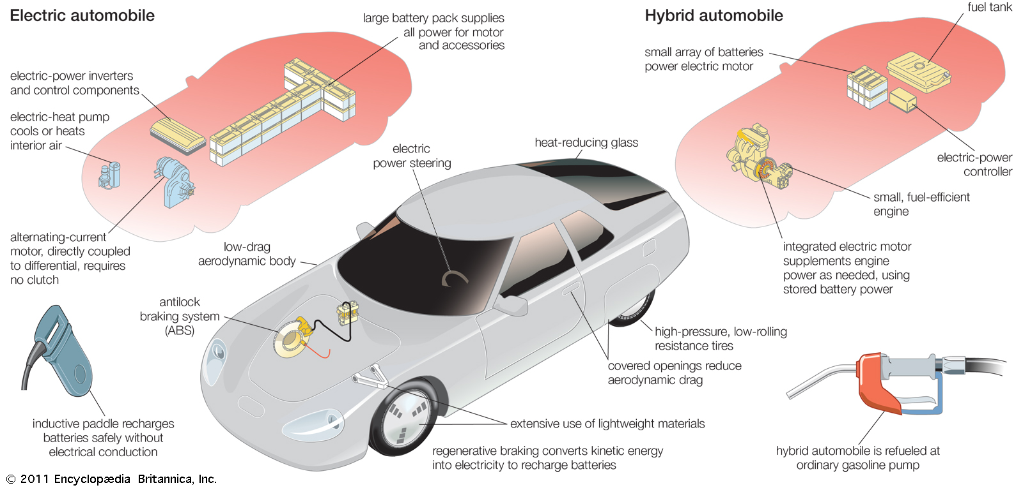
The stringent requirements on cost, reliability, performance, comfort, safety, and a dozen other parameters present a number of substantive systems engineering problems.

Slide 9
Lecture-4:16-06-22
Systems Engineering & Project Management
(Course Code: OAN0710)
What is Systems Engineering?
Difference between Systems Engineering & Conventional Engineering
Challenges & Motivation of Systems Engineering
Criteria for good Systems Engineer
Systems Engineering Landscape
Systems Engineering Approaches
Book:
Systems Engineering Principles and Practice
Authors: Alexander Kossiakoff, William N. Sweet, Samuel J. Seymour, Steven M. Biemer
Publication: A JOHN WILEY & SONS, INC. PUBLICATION, ISBN:978-1-118-00903-1
Prof. Amitava Mitra
(amitra@iitj.ac.in)
&
Dr. Mithu Rani Kuiti
mithu@iitj.ac.in)

Slide 10
Difference between Systems Engineering & Conventional Engineering
1. Looking the system in entirety
Systems engineering is focused on the system as a whole and emphasizes its total operation
whereas
the conventional engineering concentrate on the design and development of the concerned part of the system.
Systems Engineering interacts with other engineering involved in the systems and also with the environmental issues.
It looks at the system from the outside as well as from inside.
It is concerned not only with the engineering design of the system but also with external factors, which can significantly constrain the design.
Like
the identification of customer needs,
the system operational environment,
Interfacing systems,
logistics support requirements,
the capabilities of operating personnel, and such other factors
System Engineering should look the system holistically and correctly document the requirement along with the system design

Slide 11
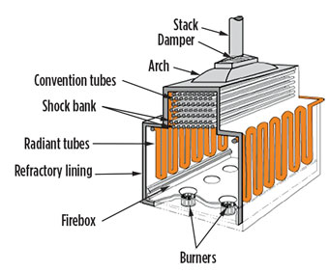
Case Study: Process heater tube made of HP-40 steel in petroleum refinery units
Operating Condition:
⇒ 1100ºC at 1MPa Pressure
 Design life of the tube 11-12 years
 Failure Occurs  4-5 years of service
Objective
Cause of Failure
Suitable Parameter to identify the damage
Development of NDE techniques for damage assessment

Slide 12
Cause of Failure:
Carbon deposited due to cracking of hydrocarbon. The carbon defuses into the steel tube at high temperature and interact with various alloying element in steel particularly with Cr present in steel and form carbides. Thus the composition of steel changes and looses its high temperature properties
The change in Composition reduces the high temperature properties. Hence the tube failure much before the design life.
The situation may be averted if a Systems Engineer look the matter in entirety

Slide 13
2. Act as a guide
Primary purpose of systems engineering is to guide. However, systems engineers also play a key role in system design.
In Traditional Engineering discipline, important design decisions entirely based on quantitative knowledge. However, in Systems Engineering important design decisions rely on qualitative judgements balancing a verity of incommensurate quantities and utilizing experience in a variety of disciplines, especially when dealing with new technology.
Systems Engineers are responsible for leading the concept development stage of a new system development, which culminates in the functional design of the system reflecting the needs of the user.
3. Bridging with others
Systems engineering bridges the traditional engineering disciplines
Systems engineers must guide and coordinate the design of each individual element as necessary to assure that the interactions and interfaces between system elements are compatible and mutually supporting
Such coordination is especially important when individual system elements are designed, tested, and supplied by different organizations.

Slide 14
What is a Computer Systems Engineer?
A computer systems engineer is someone who combines their knowledge of
Computer science,
Engineering, and
Mathematical analysis
to develop, test and evaluate software, circuits, personal computers and more.
They aren’t simply engineer of computer technology, but understand how that technology fits into the larger scheme of professional and personal needs.
A Computer Systems Engineer
understands the underlying concepts of computers,
create improvements on current processes and equipment, and
integrate hardware and software programs and concepts
to produce a fully-functional system capable of meeting his or her clients’ needs.

Slide 15
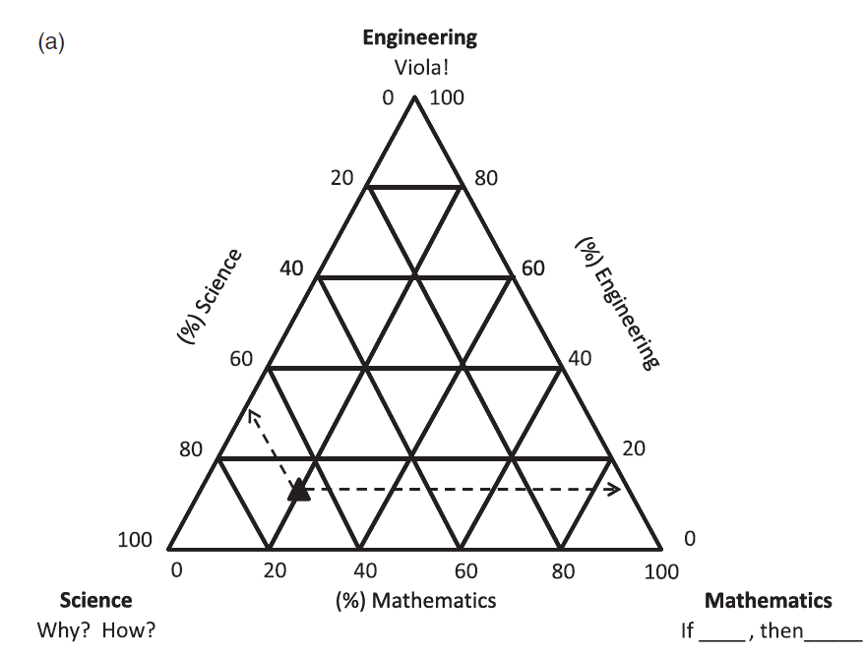
Relationship of systems engineers with respect to technical disciplines
Technical people not only engage in widely different professional specialties, but their intellectual objectives, interests, and attitudes, which represent their technical orientations, can also be widely divergent.
Engineering
(Technology)
Scientist: The typical scientist is dedicated to understanding the nature and behavior of the physical world.
(Why & How)
Mathematician: The mathematician is usually primarily concerned with deriving the logical consequences of a set of assumptions, which may be quite unrelated to the real world.
(If ‘This’ then ‘The Result?’)
(%) Science
(%) Engineering
Engineer: Usually, the engineer is mainly concerned with creating a useful process and/or product
(Technology).
Science
(Why? How?)
(%) Mathematics
Mathematics
(If_____, then_____)

Slide 16
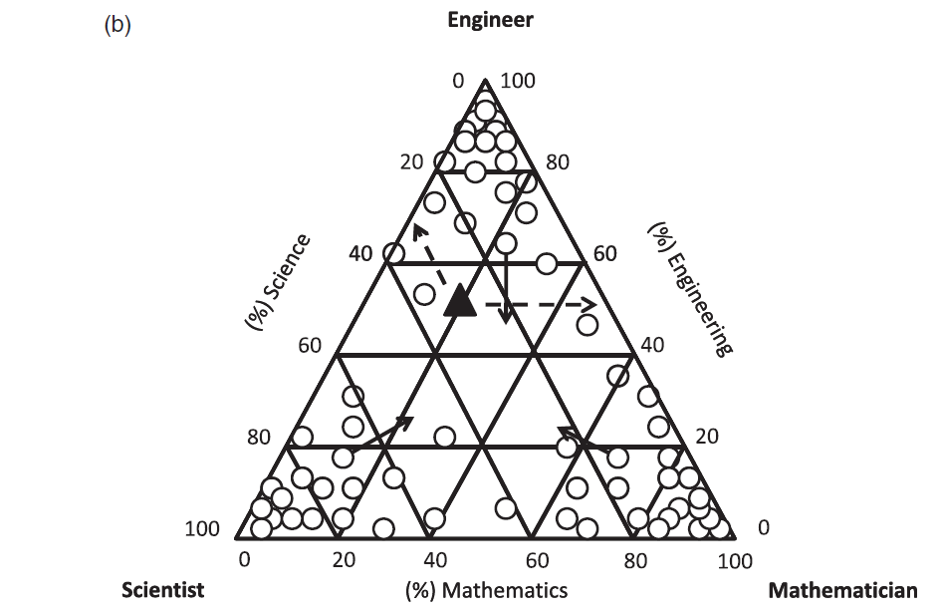
Relationship of systems engineers with respect to technical disciplines
Technical people not only engage in widely different professional specialties, but their intellectual objectives, interests, and attitudes, which represent their technical orientations, can also be widely divergent.
Engineering
(Technology)
Scientist: The typical scientist is dedicated to understanding the nature and behavior of the physical world.
(Why & How)
Mathematician: The mathematician is usually primarily concerned with deriving the logical consequences of a set of assumptions, which may be quite unrelated to the real world.
(If ‘This’ then ‘The Result?’)
(%) Science
(%) Engineering
Engineer: Usually, the engineer is mainly concerned with creating a useful process and/or product
(Technology).
Science
(Why? How?)
(%) Mathematics
Mathematics
(If_____, then_____)
Mathematics
(If_____, then_____)
Systems Engineer is more an Engineer with adequate knowledge of a Mathematician and curiosity of a Scientist

Slide 17
Most technical people resist becoming generalists for fear they will lose or fail to achieve positions of professional leadership and the accompanying recognition
The solution of complex interdisciplinary problems has had to depend on the relatively rare individuals who, for one reason or another, after establishing themselves in their principal profession, have become interested and involved in solving system problems and have learned to work jointly with specialists in various other fields.
Lead to become Systems Engineer

Slide 18
Challenges, Motivation and Characteristics of good Systems Engineers

Slide 19
The challenges for Systems Engineering
Tackling Diverse & Complicated System
Deviation from a chosen established discipline to a more diverse & complicated professional practice.
Investment of Time & Effort
It requires the investment of time and effort to gain experience and an extensive broadening of the engineering base, as well as learning communication and management skills, a much different orientation from the individual’s original professional choice.
Less individual Recognition
Change of mindset requires as it appears to be little opportunity for individual accomplishment and even less for individual recognition. For a systems engineer, success is measured by the accomplishment of the development team, not necessarily the system team leader.

Slide 20
The Motivation of Systems Engineering
Systems engineers deal with the most important issues in the system development process.
Total control of system architecture & Technical Approach
They design
the overall system architecture and the technical approach keeping in mind environmental issues
and
lead others in designing the components.
Interface between customer need and system design aspect
They prioritize the system requirements in conjunction with the customer to ensure that the different system attributes are appropriately weighted when balancing the various technical efforts.
Prioritize the risk in perusing the activity
They decide which risks are worth undertaking and which are not, and how the former should be hedged to ensure program success.

Slide 21
Characteristics to be a good systems engineer:
A systems engineer should have a creative bent and must like to solve practical problems.
An interest in the job should be greater than an interest in career advancement.
Systems engineering is more of a challenge than a quick way to the top.
The characteristic features of successful systems engineers:
System Engineers
Challenges
enjoy challenges, learning new things and solving problems,
Skeptical from ambiguity
are skeptical of unproven assertions,
Openness
are open - minded to new ideas,
S&E background
have a solid background in science, Mathematics and engineering,
Area of Excellence
have demonstrated technical achievement in a specialty area,
Overall Knowledge
are knowledgeable in several engineering areas,
Quick pick-up
pick up quickly new ideas and information from diversified and implement them in solving current problem,
Communication skill
have good interpersonal and communication skills.

Slide 22
When one has the characteristics describes earlier and is attracted to become a systems engineer, there are four more elements that need to be present in the work environment.
Seek
Assignments of Challenging Problems
One should seek assignments to problems and tasks that are very challenging and are likely to expand technical domain knowledge and creative skill.
Exposure to Big Pictures
Whatever the work assigned, understanding the context of the work and understanding the big picture is also essential.
Grow Ability for Multitasking
Systems engineers are expected to manage many activities at the same time, being able to have broad perspectives but able to deeply involve into to many subjects at once. This ability to multiplex is one that takes time to develop.
Inclination for Complex Problem
Finally, the systems engineer should not be frightened by complex problems since this is the expected work environment.

Slide 23
When one has the characteristics describes earlier and is attracted to become a systems engineer, there are four more elements that need to be present in the work environment.
One should seek assignments to problems and tasks that are very challenging and are likely to expand technical domain knowledge and creative skill.
Skeptical from ambiguity
Whatever the work assignment, understanding the context of the work and understanding the big picture is also essential.
Challenges
Exposure to Big Pictures
Assigned Challenging Problems
Quick pick-up
Grow Ability for Multitasking
Systems engineers are expected to manage many activities at the same time, being able to have broad perspectives but able to deeply involve into to many subjects at once. This ability to multiplex is one that takes time to develop.
Inclination for Complex Problem
Openness
S&E background
Area of Excellence
Finally, the systems engineer should not be frightened by complex problems since this is the expected work environment.
Communication skill
Overall Knowledge
It is clear these elements are not part of an educational program and must be gained through extended professional work experience.

Slide 24
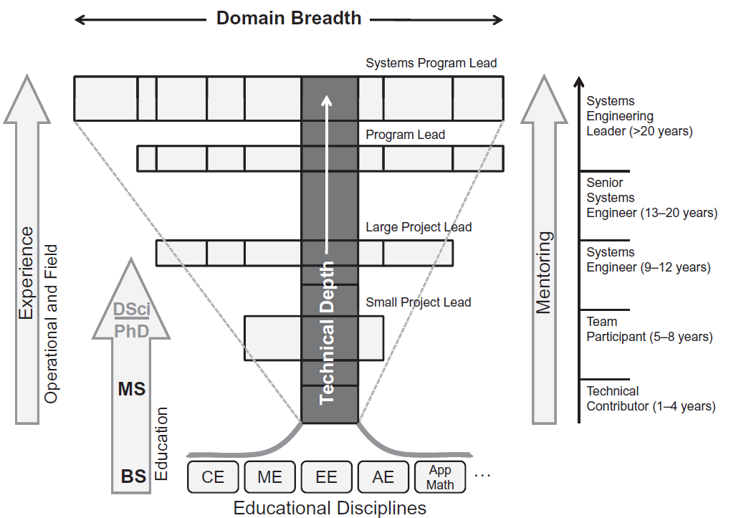
The foundation for the systems engineering career growth model and known as T-model
App. Sci
..….

Slide 25
Lecture-5:23-06-22
Systems Engineering & Project Management
(Course Code: OAN0710)
What is Systems Engineering?
Difference between Systems Engineering & Conventional Engineering
Challenges & Motivation of Systems Engineering
Criteria for good Systems Engineer
Systems Engineering Landscape
Systems Engineering Approaches
Book:
Systems Engineering Principles and Practice
Authors: Alexander Kossiakoff, William N. Sweet, Samuel J. Seymour, Steven M. Biemer
Publication: A JOHN WILEY & SONS, INC. PUBLICATION, ISBN:978-1-118-00903-1
Prof. Amitava Mitra
(amitra@iitj.ac.in)
&
Dr. Mithu Rani Kuiti
mithu@iitj.ac.in)

Slide 26
Systems Engineering Landscape
Successful Systems for Systems Engineering
The ‘Best’ System
Systems Engineering Fields
Systems Engineering Approaches

Slide 27
Successful Systems for Systems Engineering
The principal focus of systems engineering, from the very start of a system development, is the success of the system.
What is Success of the system?
1. Meeting its requirements and development objectives as per commitment to the Client,
2. Successful operation in the field,
and
3. A long, useful operating life of the system.
The systems engineering viewpoint encompasses all of these objectives.
The good or outstanding Systems Engineering viewpoint is more than the so-called objective:
4. Innovative Ideas: It looks beyond the obvious and the immediate solution to understand the user’s problems, and the environmental conditions that the system will be subjected to during its operation and solving those with innovative ideas.
5. Scope for Upgradation: It aims at the establishment of a technical approach that will both facilitate the system’s operational maintenance and accommodate the eventual upgrading that will likely be required at some point in the future.
6. Contingency plan: It attempts to anticipate developmental problems and to resolve them as early as possible in the development cycle; where this is not practicable, it establishes contingency plans for later implementation as required.

Slide 28
7. Organizational Culture: Successful system development requires the use of a consistent, well – understood systems engineering approach within the organization, which involves the exercise of systematic and disciplined direction, with extensive planning, analysis, reviews, and documentation.
8. Adaptation of New Technology: A new complex system to compete successfully in a climate of rapid technological change and to retain its edge for many years of useful life, its key components must use some of the latest technological advances. These will inevitably introduce risks, some known and others as yet unknown, which in turn will entail a significant development effort to bring each new design approach to maturity and later to validate the use of these designs in system components.
9. Risk Management: Selecting the most promising technological approaches, assessing the associated risks, rejecting those for which the risks outweigh the potential payoff, planning critical experiments, and deciding on potential fallbacks are all primary responsibilities of systems engineering. Thus, the systems engineering viewpoint includes a combination of risk taking and risk mitigation.

Slide 29
The ‘Best’ System
Systems engineering does seek the best possible system, which, however, is often not the one that provides the best performance.
Systems engineering views performance as only one of several critical attributes;
equally important ones are
affordability,
timely availability to the user,
ease of maintenance, and
adherence to an agreed - upon development completion schedule.
Thus, the systems engineer seeks the BEST SYSTEM, i.e., best balance of the critical system attributes from the standpoint of the success of the development program and of the value of the system to the user.
The interdependence of performance and cost can be understood in terms of the “Law of diminishing returns”.

Slide 30
“Law of diminishing returns”.
The law of diminishing returns states that in all productive processes, adding more of one factor of production (attribute), while holding all others constant, will at some point yield lower incremental per-unit returns.
Point of Diminishing Returns
Point of Maximum Returns
X
Most Productive
Here, your input leads to productive returns. It pays to invest more time, effort etc.
Negative Returns
Diminishing Returns
X
Total output
(Overall quality of work, total work created, etc)
Each added input leads to decreasing rate of output. It is better to stop somewhere within this phase
Never get here. Not only you will get less return for your effort, you decrease your overall output
Total input
(Time, effort, resource invested )

Slide 31
“Law of diminishing returns”.
The law of diminishing returns states that in all productive processes, adding more of one factor of production, while holding all others constant, will at some point yield lower incremental per-unit returns.
In case of Computer Systems Engineering: “ Brooks’ Law”
Brooks’ Law refers to a well-known software development principle coined by Fred Brooks in his book “The Mythical Man-Month”.
The law states that “Adding manpower to a late software project makes it later”.
This means that
when a person is added to a project team, and the project is already late, the project time is longer, rather than shorter.
Brooks' law has come up for two key reasons:
1. "Ramp up" time, which is required by new project members for productivity is complex because of the complex nature of software projects. This takes existing resources (personnel) away from active development and places them in training roles.
2. An increase in staff drives communication overhead, including the number and variety of communication channels.
Notes:
A company's sales ramp up time refers to the amount of time it takes a new salesperson to become fully productive from when they are first hired. Often, ramp time includes initial product training, sales coaching, and any and all on-boarding that is part of the new-hire process

Slide 32
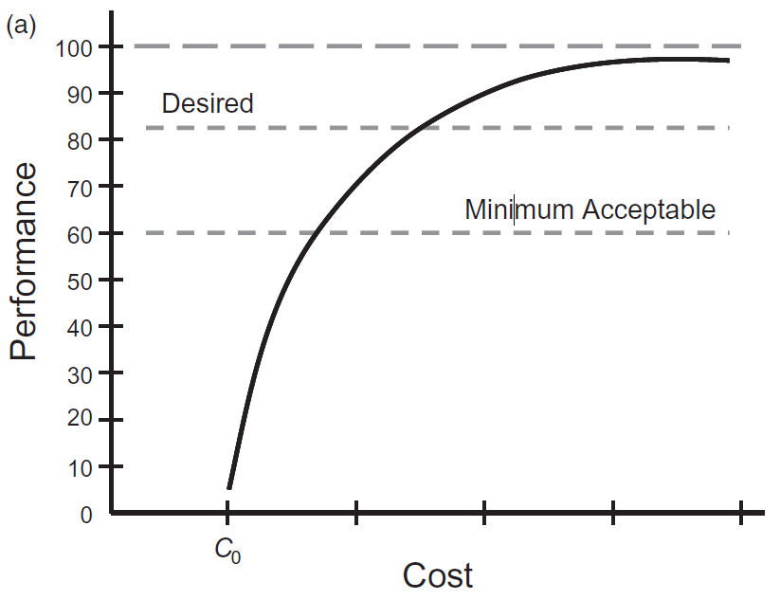
Systems Engineering View point: “Best” System
(a)
Theoretical limit
Desired Performance
Assuming a particular technical approach for achieving of a given performance attribute of a system under development
Minimum Acceptable Performance
Figure (a) is a plot of a typical variation in the level of performance of a hypothetical system component as a function of the cost of the expended development effort.
C₀ , represents the cost of just achieving any significant performance.
C₁
C₂
Theoretical limit, desired performance and minimum acceptable performance are as shown in fig.(a)
The slope is steep at first, becoming less steep as the performance asymptotically approaches the theoretical limit
Different set of process will have different set of curve

Slide 33
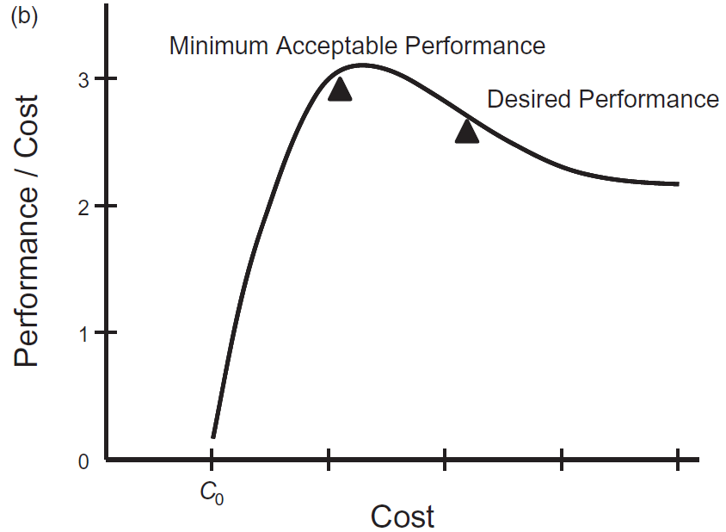
Systems Engineering View point for ‘Best’ System:
(a)
Theoretical limit
(Cost- effectiveness Analysis)
Desired Performance
An approach to establishing such a balance is illustrated in Figure (b) where performance divided by cost against cost (i.e., y / x vs. x from fig (a)).
Minimum Acceptable Performance
This ‘performance - to – cost’ ratio is equivalent to the concept of cost - effectiveness.
It is seen that this curve has a maximum, beyond which the gain in effectiveness diminishes.
(b)
Best Overall System
This shows that the performance of the best overall system is likely to be close to that where the performance/cost ratio peaks, provided this point is significantly above the minimum acceptable performance.
Desired Performance
(Cost Effectiveness)
Minimum Acceptable Performance

Slide 34
Example of ‘Best” System for development automobile with higher maximum speed
Direct approach: Go for engine that generates greater power and hence more speed to automobile.
Problem:
1. Such an engine would normally be larger, weigh more, and use fuel less efficiently.
2. An increase in speed will result in greater air drag, which would require a disproportionately large increase in engine power to overcome.
New approach for higher maximum speed:
Require to maintain
a) fuel economy and
b) retain vehicle size and weight as nearly same as possible
using more advanced engine, improving body design with special lightweight materials
Above factors would escalate the cost of the modified automobile, with the incremental costs increasing at each stages.
It is obvious, therefore, that a balance must be struck well short of the ultimate limit of any performance attribute.

Slide 35
Systems Engineering Fields:
1. Systems engineering has a strong connection bridging the traditional engineering disciplines like EE, ME, CE. CS……. It is expected that engineering specialists look at systems engineering with a perspective more strongly from their engineering discipline.
2. Systems engineering is a guide to design of systems often exercised in the context of a project or program, the Management elements of planning and control to be key aspects of system development.
The management support functions that are vital to systems engineering success such as
Project Management
Quality management,
Human resource management, and
Financial management
Operational Research
Traditional
engineering
fields
Systems Engineering Fields
can all claim an integral role and perspective to the system development.
Management
Fields
Financial Management
3. The area of Operations Research whose view of systems engineering includes provision of a structure that will lead to a quantitative analysis of alternatives and optimal decisions
Project Management
Human Resources
Quality

Slide 36
SYSTEMS ENGINEERING FIELDS
4. The design of systems also has a contingency of professionals who focus on the structures and architectures.
5. In diverse areas such as manufacturing to autonomous systems, another interpretation of systems engineering comes from engineers who develop control systems. Systems engineering focuses on management of interfaces and feedback systems.
6. Finally, the overlap of elements of modeling and simulation with systems engineering provides a perspective that is integral to a cost - effective examination of systems options to meet the requirements and needs of the users.
As systems engineering matures, there will be an increasing number of perspectives from varying fields that adopt it as their own.
Operational Research
Modelling & Simulation
Traditional
engineering
fields
Systems Engineering Fields
Management
Fields
Financial Management
Project Management
Control Systems
Human Resources
Quality
Architectures

Slide 37
Systems Engineering Approaches
Top-down approach
Interdisciplinary approach
Effort on more complete definition of system requirements
Life cycle engineering approach

Slide 38
Systems Engineering Approaches
Emphasis on
Top-down approach
Life cycle engineering approach
Top-down approach
Look at system from top
Decide inputs/outputs taking into account the supersystem
Decide subsystems
… down to lower levels

Slide 39
Top-down Approach to Software Development
In order to understand software systems, a developer needs to recognise what software is at both of its largest and smallest levels, essentially acknowledging the different components that make up a system at different levels.
Outline below is a breakdown of different “levels” of software from largest to smallest
System:
Multiple programmes working together to achieve a common goal. e.g. Google Drive, Microsoft Office
Programme:
An individual software that has been developed for a specific purpose. e.g. Words, Excel
System
Module:
Stand alone parts within a piece of software used for achieving different tasks. e.g. Mail Merger, Slide Show
Programme
Programme
A sequence of steps that achieve an objective, which is a part of a larger programme. e.g. Recording and recalling variable
Subprogramme:
Module
Module
Module
Module
Subprog
Subprog
Subprog
Subprog
Subprog
Subprog
Subprog
Subprog
Statement:
A line of code within a programme. e.g. Declaring a variable
Foundation element of all Software are STATEMENTS created with Code

Slide 40
Advantage of Top down approach
1. Breaking the problem into parts helps us to clarify what needs to be done
2. At each step of refinement, the new parts become less complicated and therefore, easier to figure out
3. Parts of the solution may turn out to be reusable in other system
4. Breaking the problem into parts allows more than one person to work on the solution
Disadvantage of Top down approach
Low participation (this is likely to influence the implementation of the plans in a negative way).
2. Requires a lot of knowledge at the top level.
3. Does not use specialized knowledge which may be present in the lower echelons of the organization.

Slide 41
Life cycle engineering approach
Initial approach was Design cycle
Later with Design for Manufacture (DFM) approach. Manufacturing cycle also included
Present thinking is to consider three life cycles i.e. Design, Manufacturing and Deployment
Development phase
Utilization phase
Conceptual & Preliminary Design
Detail Design & Development
Production and/or Construction
Design
NEED
Product use Phase out and Disposal
Manufacture
(Engineering)
Manufacturing Configuration Design
Manufacturing Operations
Product support configuration design and development
Product support and maintenance
Deployment

Slide 42
System Life Cycle in Systems Engineering
The system life cycle in systems engineering is a view of a system or proposed system that addresses all phases of its existence which can be broadly classified into three broad stages and to partition into eight distinct phases.
The three stages will be referred to as
The CONCEPT DEVELOPMENT stage:
This is the initial stage of the formulation and definition of a system concept perceived to best satisfy a valid need
Concept Development
Engineering Development
Deployment
Need Analysis
Advanced Development
Utilization &
Support
(2) The ENGINEERING DEVELOPMENT stage:
This covers the translation of the system concept into a validated physical system design meeting the operational, cost, and schedule requirements;
Conceptual & Preliminary Design
Manufacturing Configuration Design
Phase-out and disposal
and
Manufacturing Operation
(3) The DEPLOYMENT stage:
This stage includes the production, deployment, operation, support of the system throughout its useful life and also the Disposal plan.
Detailed Design & Development

Slide 43
Thank you

